Slide 1
Prediction of Intensity of Earthquakes
Team -
Jaya Prakash Lavdyavath (YD00257)
Prashanthi Ponakalla (FH16094)
Sai Vara Prasad Settipalli (EP53338)

Slide 2
ABSTRACT
The object of this work is to identify the intensity of earthquakes that occurred between the period of 1906 to 2022 globally. We perform multiple Machine learning models on data to learn the trend of ground motion intensity using factors like Latitude, Longitude, and Depth etc. The input data is taken from a dataset that is already existing and contains real-time facts on earthquakes. Performing various models using ML algorithms gives us the best method that provides accurate value. We can improve Earthquake emergency measures and take necessary precautions in advance by predicting the intensity of Earthquakes considering the previous data analysis.

Slide 3
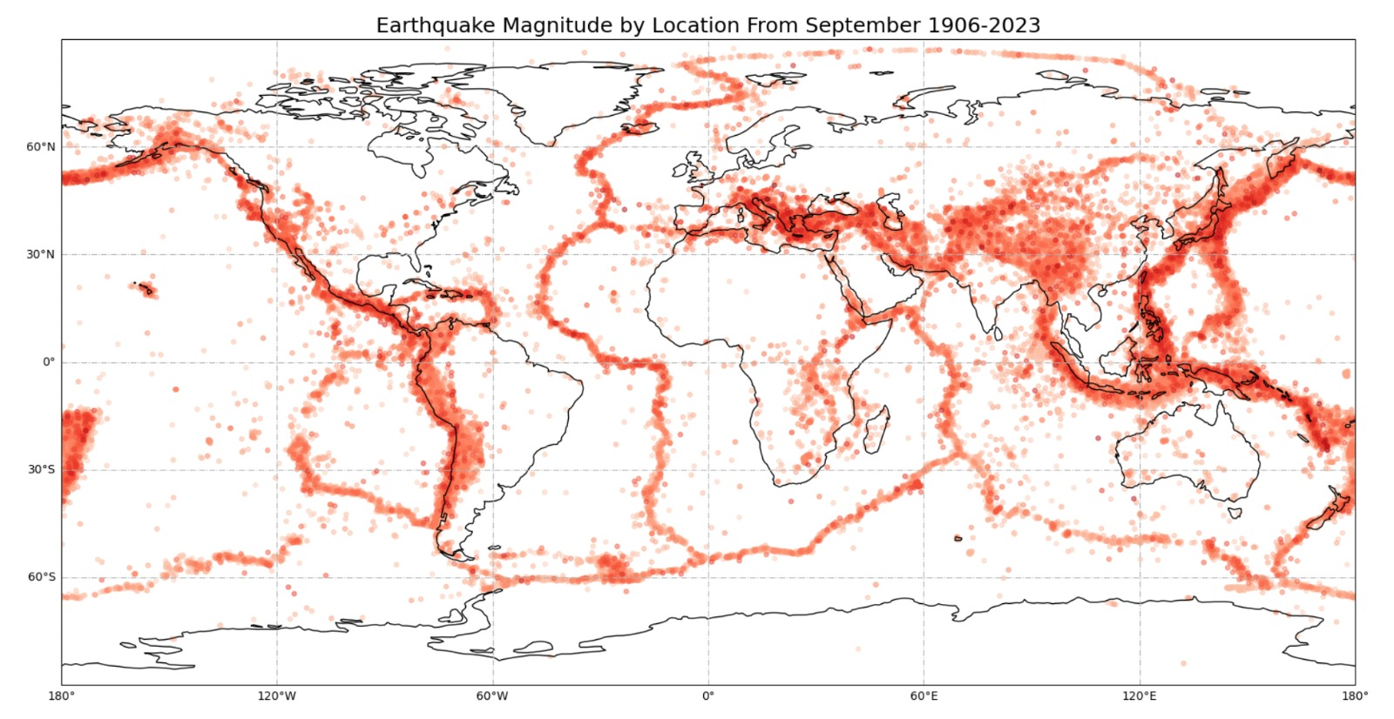
The following image show the areas that are affected by the Earthquakes

Slide 4
DATA SOURCE
https://www.kaggle.com/datasets/garrickhague/world-earthq uake-data-from-1906-2022?resource=download
Size of the dataset is 12 mb.
The dataset contains 283,132 rows and 21 columns.

Slide 5




Tools
Jupyter Notebook
Streamlit
Python Programming
Machine Learning Models
ChatGPT

Slide 6
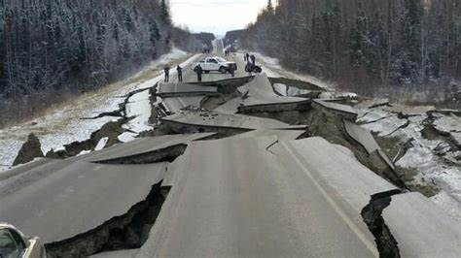
What is the problem
One of the most disastrous natural occurrences is an Earthquake. As Earthquakes can occur with different magnitudes, it is uncertain about what measures to be taken in consideration of the severity of Earthquake. The high severity of Earthquake leads to many destructions and loss of lives & properties. Severity increases as magnitude increases and decreases as distance from the causative fault increases. Earthquakes also leads to landslides, tsunamis and fault ruptures, these can causes more damage to the human resources and mankind.

Slide 7
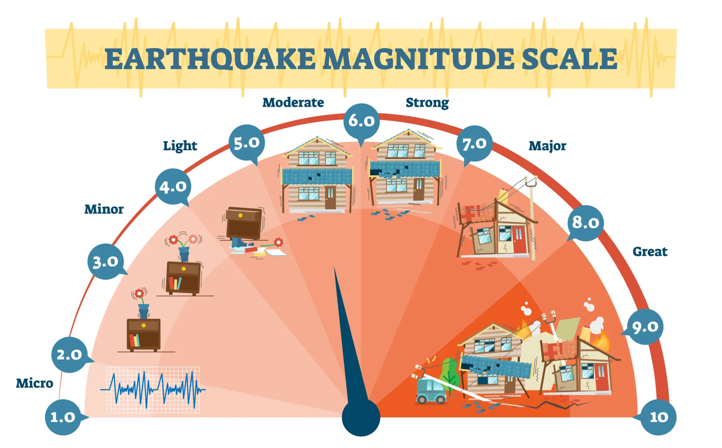
Why was that a good problem
If the problem is known, we can find a solution for it. If We can find the intensity of the earthquake in prior, we can issue early warnings to the people which gives them time to evacuate or take other protective measures to minimize damage and loss of life.
The mentioned problem is a real time issue that people are still victims as it leads to a huge loss. So we can study more about magnitude of earthquake magnitudes and intensity. This can lead to new insights and innovations that can help mitigate the damage caused by earthquakes in the future.

Slide 8
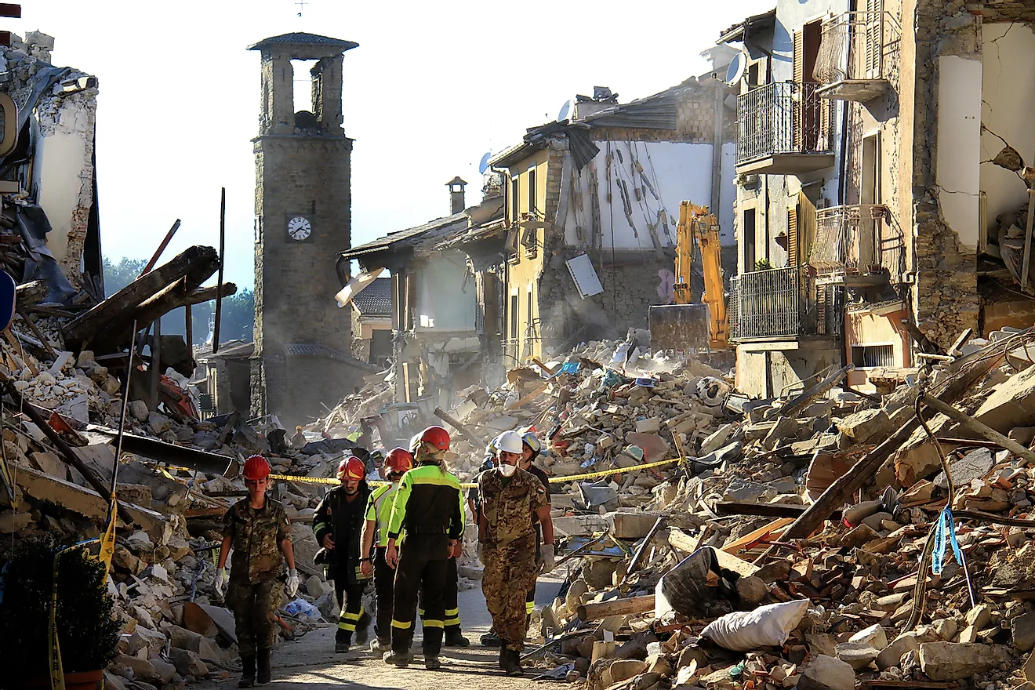
Knowing the intensity of an earthquake can help authorities allocate resources more effectively. They can prioritize rescue and relief efforts based on the severity of the quake and the level of damage it is likely to cause.
People can also prepare better in advance like they can reinforce buildings, secure valuable possessions, and stock up on emergency supplies.
The damage caused by an earthquake can have significant economic impact, particularly in areas with a high concentration of businesses. According to the intensity of earthquake this situation can also be saved.

Slide 9
What were the major hurdles
There was limited Earthquake data that suited our requirements. We searched many datasets and found less information about the earthquakes factors those are required for analysis.
Choosing the right features to include in model was challenging and little time taking.
The raw data collected from various sources was pre processed to ensure it meets the requirements and relieved many datasets those did not satisfy the specifications.

Slide 10
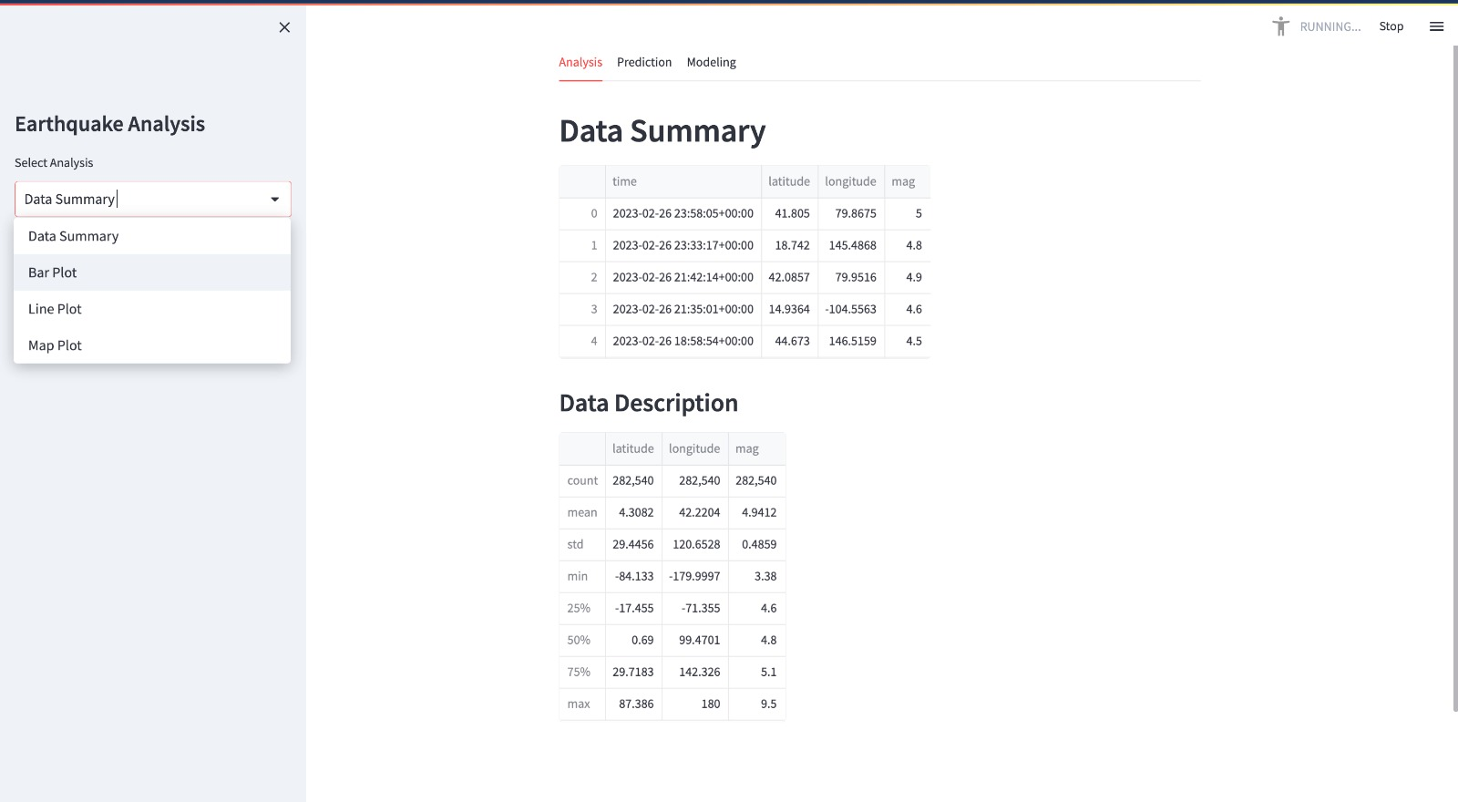
Results
Representation of various plots, models and data summary using Steamlit.

Slide 11
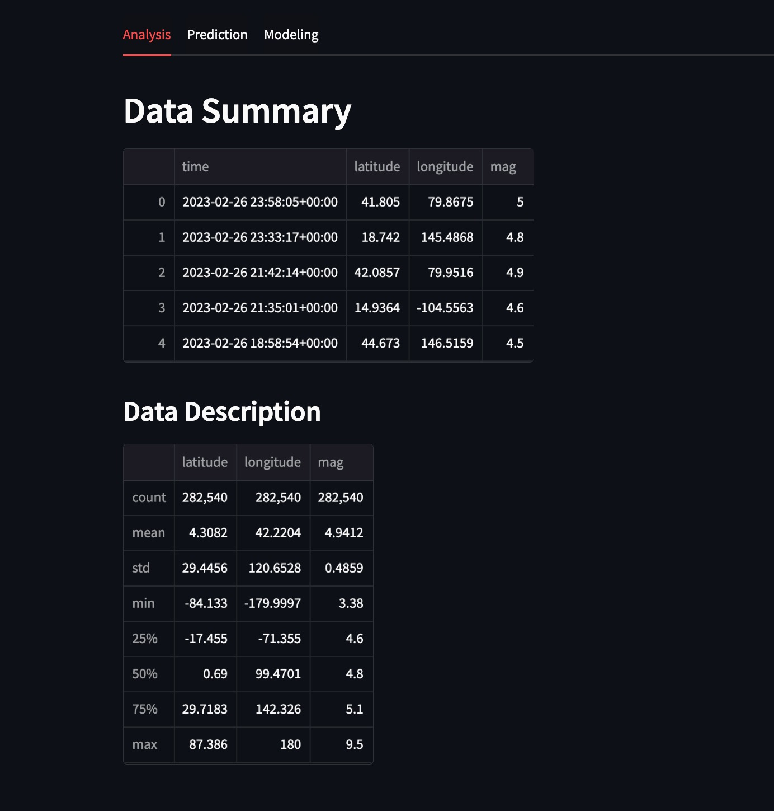
Results
After performing the required sequences of steps in Exploratory Data Analysis, there are several changes to the Dataset.
The unwanted data such as null values, missing data, and redundant data was eliminated to make the data best suitable for applying Machine Learning algorithm.
Here is the numeric values after performing the different functions on the dataset.

Slide 12
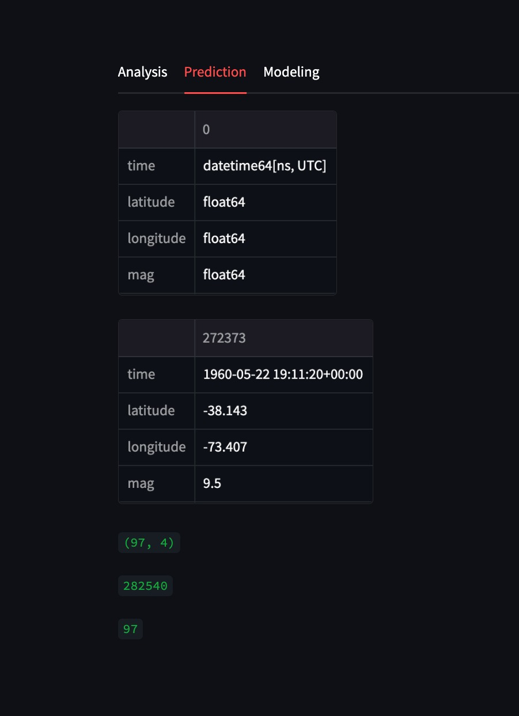
Results
Based on the concluded values from dataset, the key factors such as latitude, longitude, and Magnitude are identified.
These values represents the specific location with certain magnitude that indicates the severity of Earthquake.

Slide 13
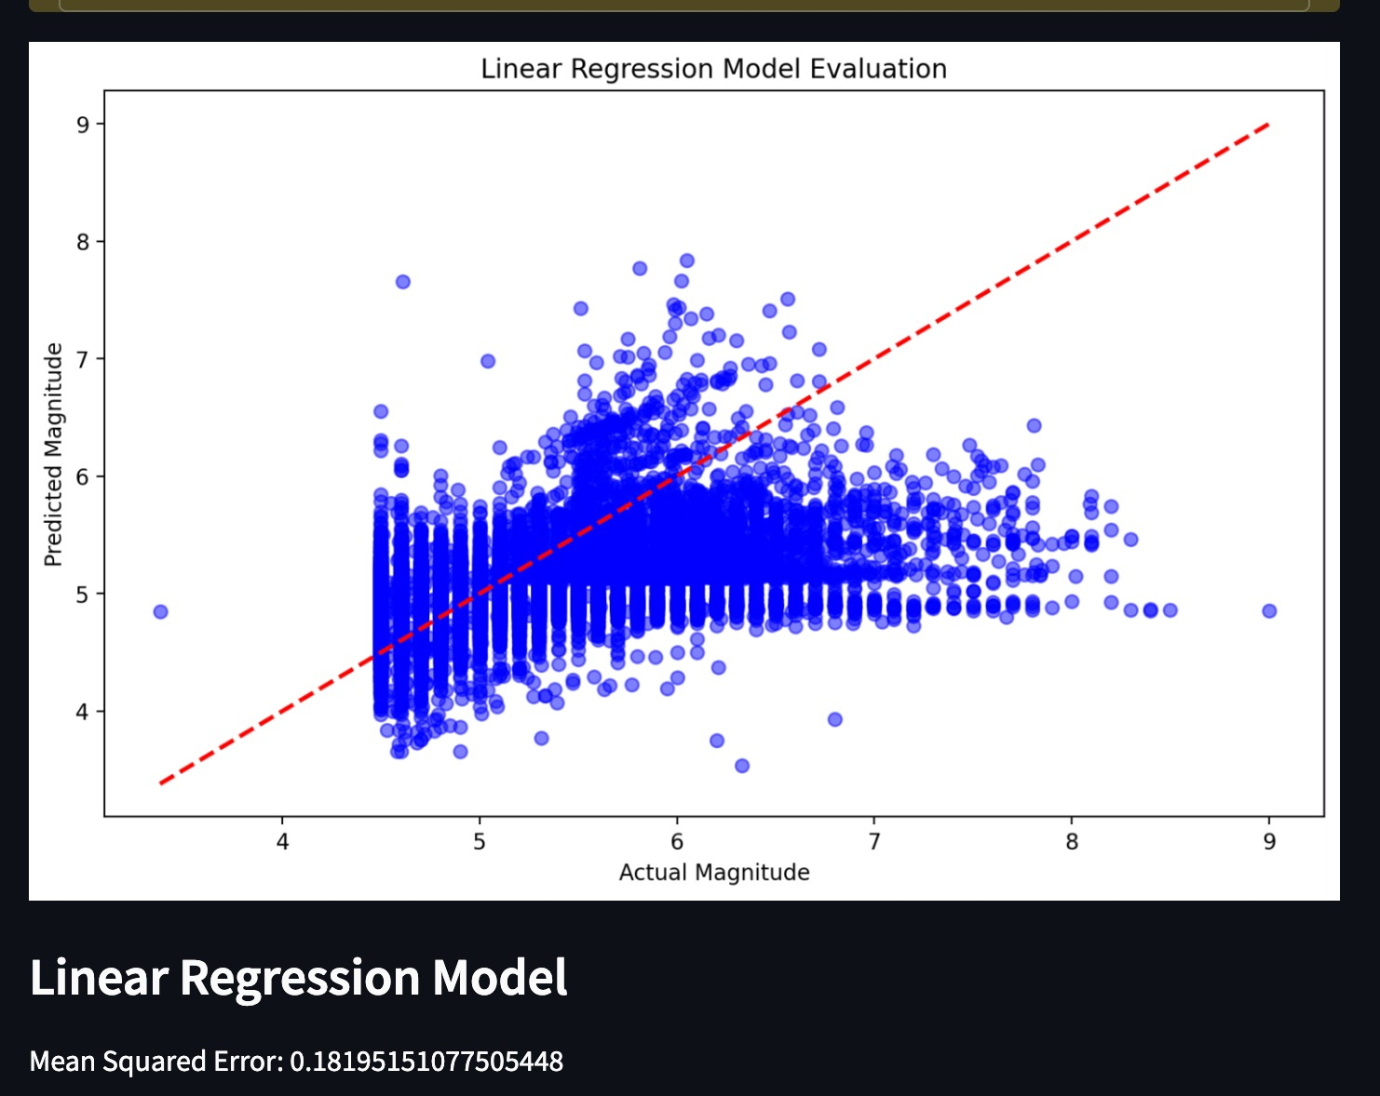
Results
Linear Regression: Linear regression is a type of supervised learning algorithm used for predicting a continuous target variable based on one or more input variables.
In the context of predicting earthquake data, linear regression can be used to model the relationship between the magnitude of an earthquake and its corresponding ground motion intensity.

Slide 14
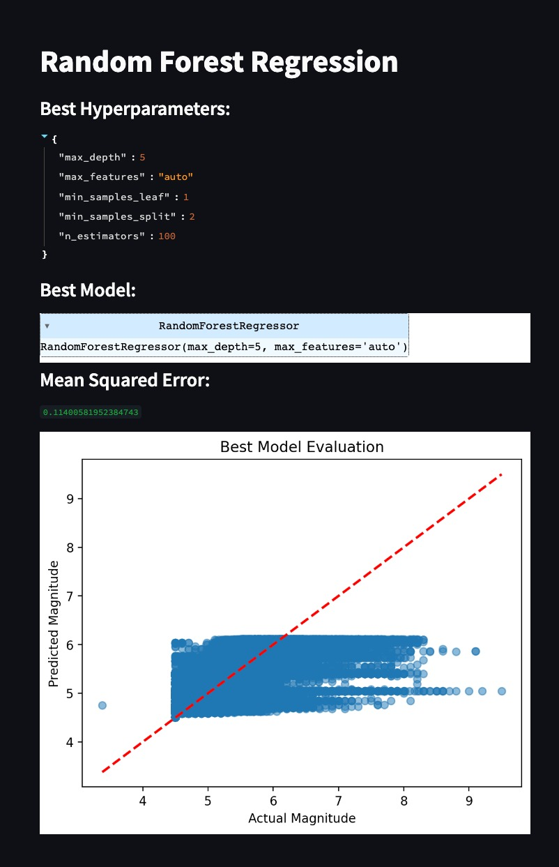
Results
Random Forest Regression: Random Forest Regression is a machine learning algorithm that uses decision trees to predict a continuous target variable, such as ground motion intensity in earthquake prediction.
In this context, random forest creates the best model in predicting the magnitude of earthquakes.

Slide 15
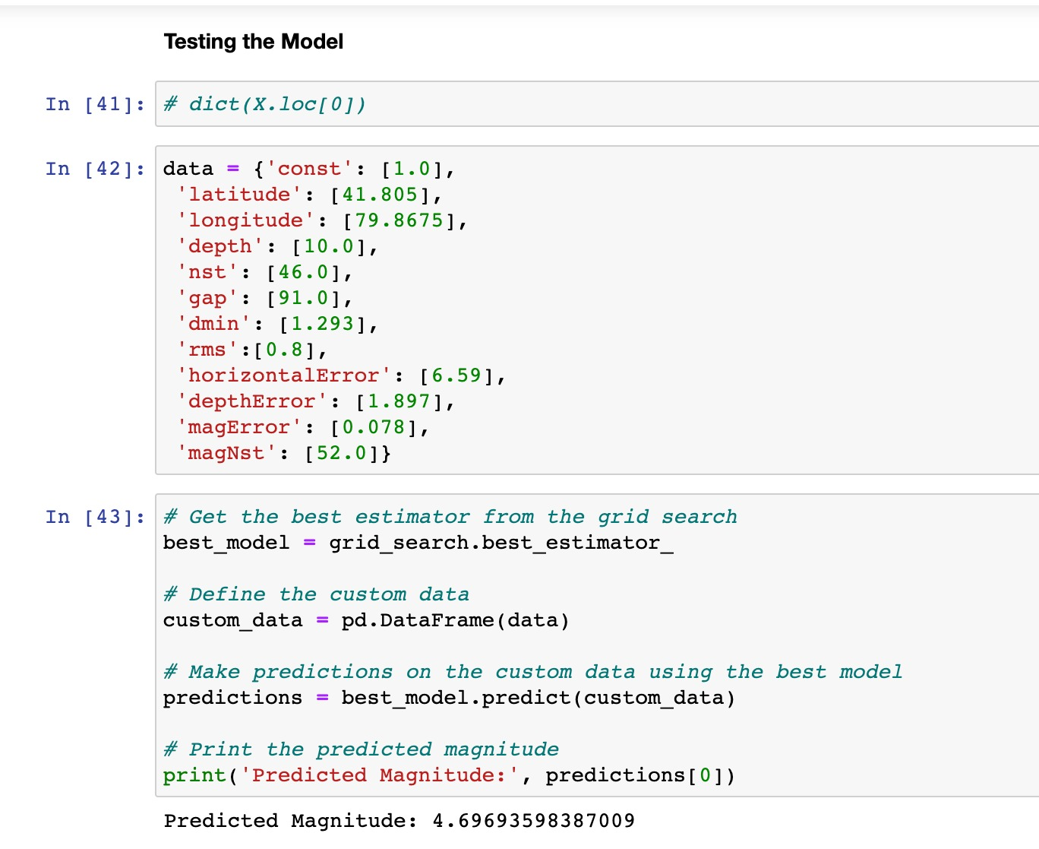
Results
This image contains the details about testing of the Model that predicts the Magnitude.
Considering the factors such as latitude, longitude, depth, etc the magnitude is predicted to indicate the intensity of earthquake in specific location.

Slide 16
Future Enhancements
Infrastructure and building design: The intensity of earthquakes provides valuable data for engineers and architects when designing and constructing buildings, bridges, and other critical infrastructure. By understanding the intensity, they can develop structures that are more resistant to seismic forces, enhancing public safety and reducing the risk of damage or collapse during future earthquakes.
Urban planning and zoning: Knowledge of earthquake intensity can inform urban planning and zoning regulations. Areas prone to higher intensities can be designated for appropriate land use, such as avoiding the construction of critical facilities or densely populated areas.
Risk assessment and insurance: Intensity information plays a vital role in assessing seismic risk for insurance purposes. Insurance companies can determine premiums and coverage based on the expected intensity levels in a specific region. It allows individuals, businesses, and governments to make informed decisions regarding insurance coverage and risk management strategies.

Slide 17
Conclusion
To predict the magnitude, the factors such as latitude, longitude, and depth are mainly used from the dataset. To create the best model, several ML algorithms are performed in which Random Forest made more impact and gave the best output. Moreover, in consideration of future safety, such models can be used to avoid or minimize the loss occurs due to Earthquakes.

Slide 18


